Slide 1
Case 4: GC Dr. Sekkath Veedu
74 year old male
Diagnosis: Metastatic squamous cell carcinoma of the lung (Stage IVB; cM1b), initially diagnosed in 3/2023; with a T6 metastasis and progressive mediastinal lymphadenopathy
Other Clinical Information:
Performance Status: 1
Hepatic Function: AST 29; ALT 19; ALP 335; T. Bili 0.3; Albumin 3.7; T Protein 7.2
Renal Function: BUN 17; Cr. 0.45
Family History: Lung cancer in mother and father, bone cancer in brother
Comorbidities: Pulmonary fibrosis, former smoker (35 pack year hx, quit 2020)
Oncology History:
2/2023 – 2/2025: Pembrolizumab
Current: Carboplatin / paclitaxel + RT (6000cGy in 30 fractions)
Molecular Testing:
Specimen Site: Thoracic lymph node; Collected: 4/2025; Panel: Caris; Dated: 4/2025

Slide 2
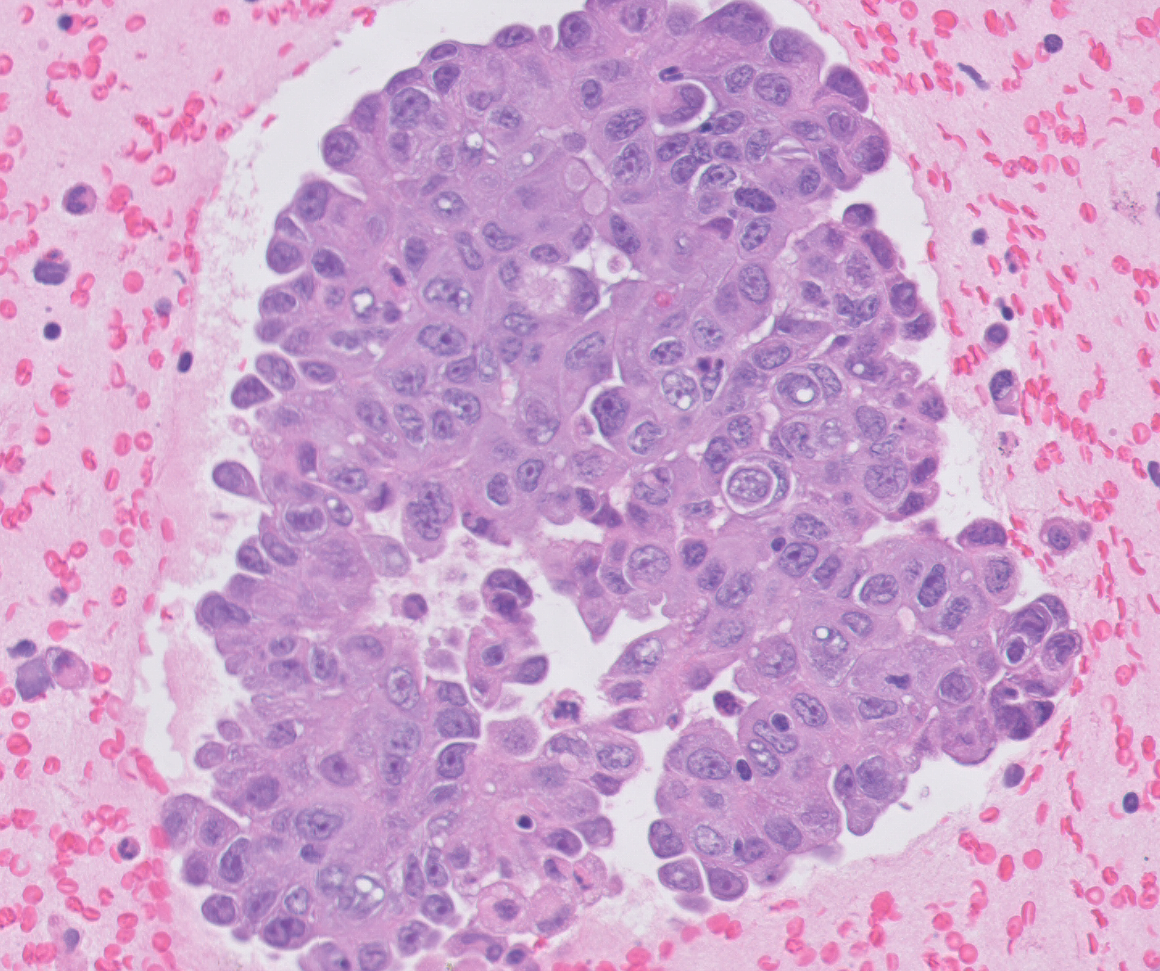
Case 4
Station 7 lymph node: Metastatic adenocarcinoma, compatible with a lung primary
Intracytoplasmic mucin, indicative of glandular differentiation (arrows)

Slide 3
Case 4 Prior: pembro (2/2023 – 2/2025) Caris Current: carbo/paclitaxel + XRT(planned) Dx: lung squamous
Alteration | Function | Oncogenic | On-label | Clinical Trial | Off-label (Evidence level) | Allele frequency (%)
MET | Receptor tyrosine kinase; PI3K/MEK pathways | 100%, 3+ | None | NCT04270591 (Ph 1b/2) NCT03175224 (Ph 1/2) NCT04693468 (Ph 1b) NCT06083857 (Ph 1/2) | Telisotuzumab vedotin (2L+) | n/a
KRAS G12C | GTPase ; MAPK signaling | Yes, gain | Sotorasib, adagrasib (2L+) | None | None | 45
ARID2 G1699* | Transcription regulation; DNA repair | Likely, loss | None | NCT05687136 (Ph 1b) | None | 42
ASXL1 I617fs | Epigenetic regulator | Likely, loss | None | None | None | 6
TP53 R273C | DNA repair and apoptosis | Likely, loss | None | None | None | 36
LOH | Loss of heterozygosity | 11%, equivocal | None | None | None | n/a
TMB | Measures mutation/Mb DNA | 4, low | None | None | None | n/a
MSI | Measures hypermutability | Stable | None | None | None | n/a
PD-L1 | Measures response to immunotherapy | TPS 98% | Immunotherapy (PD) | None | None | n/a
Notes:
4/15/25 collected
Initial PD-L1 70%
Hx of pulmonary fibrosis
KRAS: note that KRYSTAL-1 (adagrasib), there are only 3 (2.6%) pts with squamous etiology but approved for all NSCLC. CodeBreaK100 (sotorasib) only had 1 (0.8%) with squamous etilogy
MET
NCT04270591 (Ph 1b/2): glumetinib (selective METi), NSCLC w/ Met alterations (Met amp GCN >4, MET IHC 2+), closest in Louisville (preliminary, 4 MET overexpressed NSCL (1 PR, 3 SD)
NCT03175224 (Ph 1/2): APL-101 (cMETi), Cohort F (MET overexpression, unknown cutoff), closest in SCRI or Ohio State
NCT04693468 (Ph 1b): Talazoparib + Crizotinib, Arm C (MET defects, unknown cutoff), only MDACC
NCT06083857 (Ph 1/2): amivantamab + tepotinib, MET skipping, amp, overexpression IHC 3+, MDACC only
ARID2
NCT05687136 (Ph 1b): NCT05687136 (Ph 1b): peposertib (DNA-PK inhibitor) + tuvusertib (ATRi), ATM mutations, amplification of MYC, mutation of FBXW7, CCNE1 amplification, SWI/SNF member mutation (ARID1A, PBRM1, SMARCA4, ARID2, ARID1b, SMARCA2, SS18), and ATRX/DAXX, only at NCI or Boston

